Slide 1
Lecture 1-2
FUNDAMENTALS OF SOFTWARE ENGINEERING
Mehwish Mumtaz

Slide 2
Text Book
Roger Pressman, Software Engineering: A Practitioner’s Approach(Selected Chapters)
Shari Lawrence PFleeger and Joanne M. Atlee, Software Engineering Theory and Practice, Fourth Edition (Selected Chapters)
Ian Sommerville, Software Engineering (Selected Chapters)

Slide 3
Why is SE Needed?
Computers everywhere
Toaster, Microwave, Temperature control of A/C, Surgical Equipment…
Computers need to be managed
Software runs on all computers
Make lives comfortable, efficient, effective…
E.g Document system. Estamping PITB
SE practices ensure development of good software to improve our living standard

Slide 4
Why Do We Need to Study SE?
What could be the benefits?

Slide 5
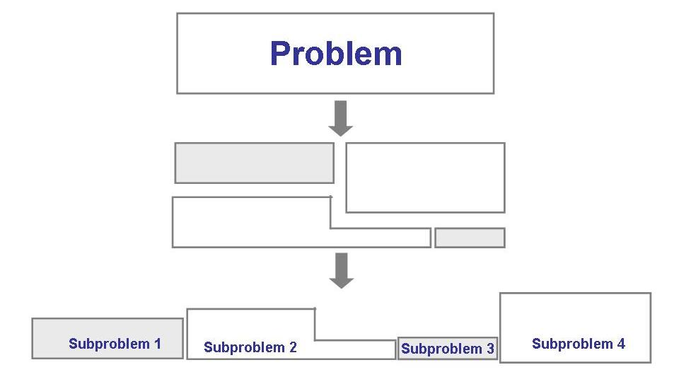
Solving Problems
Analysis

Slide 6
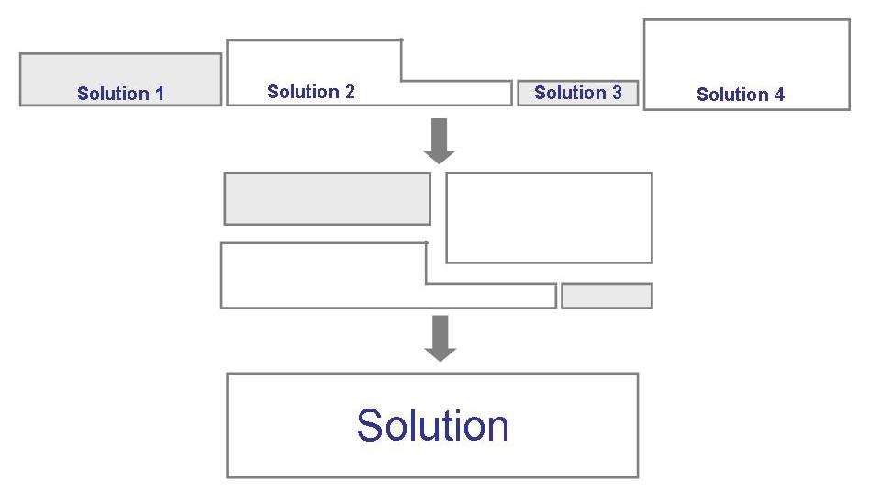
Solving Problems (continued)
Synthesis

Slide 7
Software Engineering
Solving Problems
Computers
Computing

Slide 8
Software?
Computer programs along with associated configuration data and documentation s.t. the programs are correctly operated
Configuration data helps set up the programs
System documentation helps understand structure of the system
User documentation explains how to use the system

Slide 9
Engineering?
Engineers’ Job?
Make things work
Apply theories, methodologies, tools appropriately
Provide solutions in absence of applicable theories and methods
Realize financial and organizational constraints

Slide 10
Aspects of Software Production?
Technical process of developing software
Activities such as management of project and teams
Development of tools, theories, methods to support production of software

Slide 11
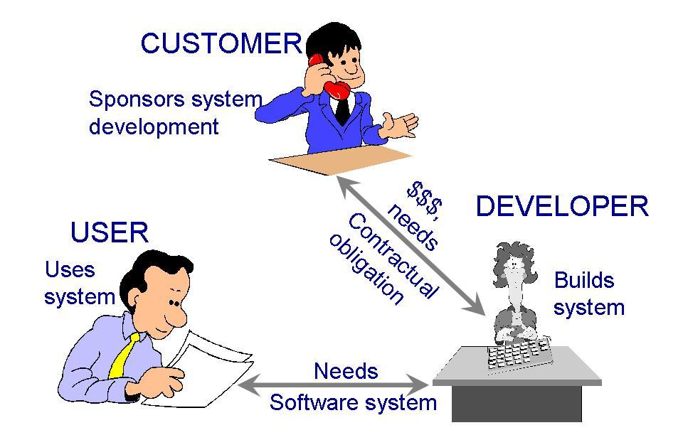
Who Does Software Engineering?
Participants (stakeholders) in a software development project

Slide 12
Challenges for Software Industry
 | 2012 | 2013 | 2014 | 2015 | 2016
Successful Projects | 27% | 31% | 28% | 29% | 32%
Challenged Projects | 56% | 50% | 55% | 52% | 49%
Failed Projects | 17% | 19% | 17% | 19% | 19%
Report for Year 2012 to 2016 (Standish 2016)
Factors Affecting Project Success Rate
Project Size and Complexity
Customer Satisfaction Level
Development and Budget Process
Skills of Developers and Managers
are

Slide 13
Development Team
Requirement analysts: work with the customers to identify and document the requirements
Designers: generate a system-level description of what the system is supposed to do
Programmers: write lines of code to implement the design
Testers: catch faults
Trainers: show users how to use the system
Maintenance team: fix faults that show up later
Librarians: prepare and store documents such as software requirements
Configuration management team: maintain correspondence among various artefacts

Slide 14
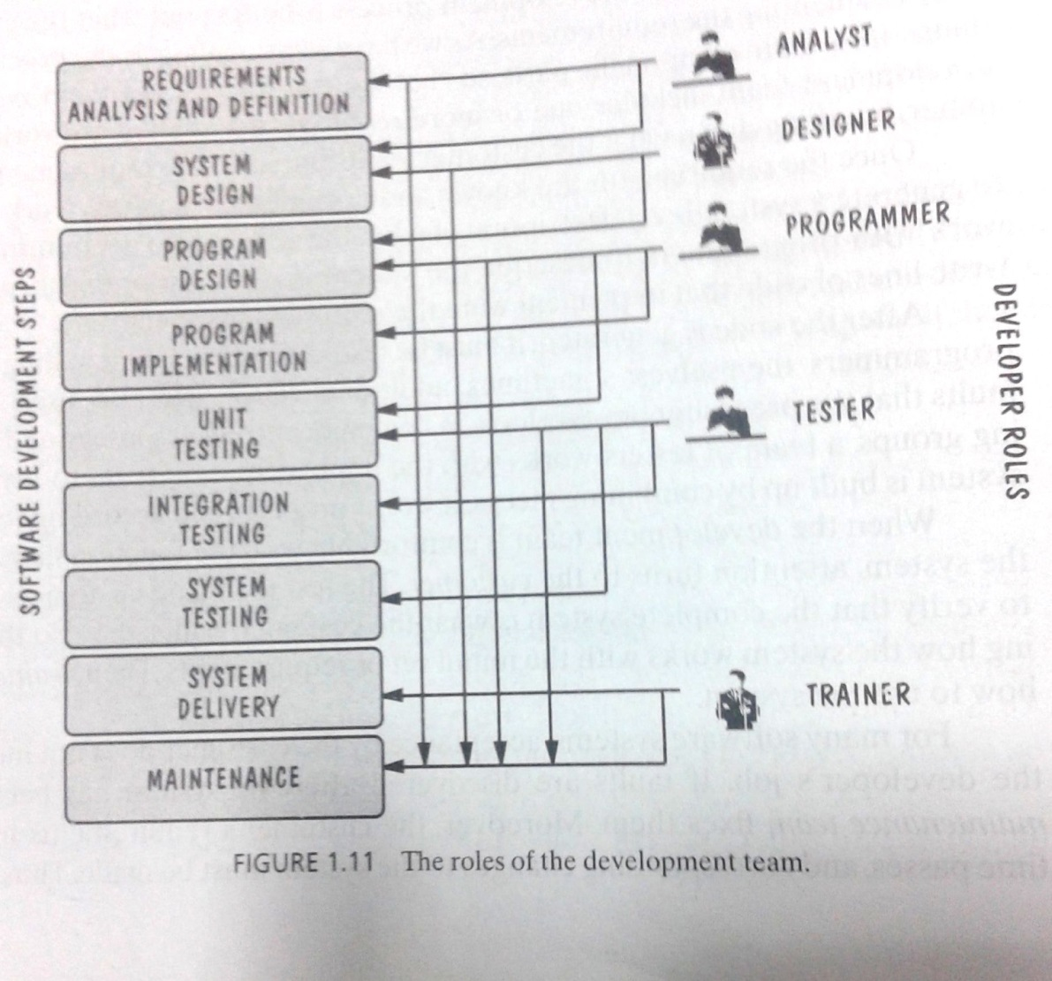
Development Team (Roles)
Who Does What?

Slide 15
Paradigm
(Models)
Resources
Software Engineering
Process
Skillset
Lifecycle
Requirements Analysis | Design | Coding | Testing | Deployment | Maintenance
Typical phases in lifecycle of software

Slide 16
Software Lifecycle
Phases
Requirements analysis and definition
System (architecture) design
Program (detailed/procedural) design
Writing programs (coding/implementation)
Testing: unit, integration, system
System delivery (deployment)
Maintenance

Slide 17
Software Engineers?
Adopt a systematic and organized approach, effectively, to produce high quality software
May have to use Ad hoc(Necessary) approaches to develop software
Some real complex problems may not be solved using elegant theories of CS

Slide 18
What is a Good Software Product?
Good software engineering must always include a strategy for producing quality software
Product Quality?
Multiple facets…

Slide 19
What is a Good Software Product?
Users judge external characteristics (e.g., correct functionality, number of failures, type of failures)
Designers and maintainers judge internal characteristics (e.g., ease of modification)
Thus different stakeholders may have different criteria
Need quality models

Slide 20
What is a Good Software Product? McCall's Quality Factors
Correctness
The extent to which a software meets its requirements specification.(Fulfill Customer Objective).
Functional Requirements: Directly specify e.g Mobile application
Non functional Requirements: Loading time of application, Performance of the application
Efficiency
The amount of hardware resources and code the software, needs to perform a function.
Integrity
The extent to which the software can control an unauthorized person from the accessing the data or software.
Reliability
The extent to which a software performs its intended functions without failure.(Not a serious error. Therac 25. We expect errors)
Usability
The extent of effort required to learn, operate and understand the functions of the software.

Slide 21
What is a Good Software Product? McCall's Quality Factors
6. Maintainability –
The effort required to detect and correct an error during maintenance phase. (Modification in Initial release, bug fixing phase, software evolution phase, old software and reverse engineering)
7. Flexibility The effort needed to improve an operational software program.
8. Testability – The effort required to verify a software to ensure that it meets the specified requirements.
9. Portability – The effort required to transfer a program from one platform to another.
10. Re-usability – The extent to which the program’s code can be reused in other applications. E.g Car
11. Interoperability – The effort required to integrate two systems with one another.

Slide 22
Lehman’s Laws of Software Evolution
(1974) "Continuing Change" — A system must be continually adapted or it becomes progressively less satisfactory. It happens so until it becomes economical to replace it by a new or a restructured version.-Add new features e.g Soneri Bank software
(1974) "Increasing Complexity/Entropy" —Complexity/entropy of a system increases with time, unless work is done to maintain or reduce it-lines of code
(1991) "Continuing Growth" — the functional content of a system must be continually increased to maintain user satisfaction over its lifetime
(1996) "Declining Quality" — the quality of a system will appear to be declining unless it is rigorously maintained and adapted to operational environment changes

Slide 23
Software Engineering
Disciplined, consistent, and systematic effort to construct (design + build) and maintain good quality software in timely and cost-effective manner

Slide 24
How Successful Have We Been
Perform tasks more quickly and effectively
Word processing, spreadsheets, e-mail
Support advances in medicine, agriculture, transportation, multimedia education, and most other industries
Many good stories
However, software is not without problems (recall the Standish report on challenged and failed projects???)

